Slide 1
Protective versus Participatory: Why We Need a Different Way to Do Research
Stephanie Malia Fullerton, DPhil
Bioethics & Humanities

Slide 2
Overview
Current research practices in human genomics emphasize upfront assurances and risk mitigation over on-going engagement
Some data suggest that research participants may prefer more active involvement in the research process
Facilitating respectful, on-going, engagement in the research process will be important moving forward

Slide 3
Wide Data Sharing a Scientific Good
“The full value of GWAS to the public can be realized only if the genotype and phenotype datasets are made available as rapidly as possible to a wide range of scientific investigators”…
http://grants.nih.gov/grants/guide/notice-files/not-od-06-094.html
Notes:
3

Slide 4
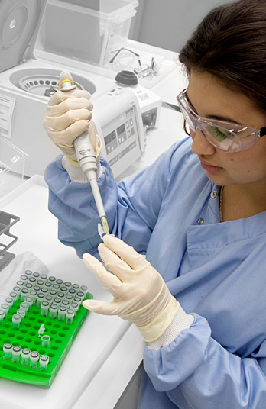
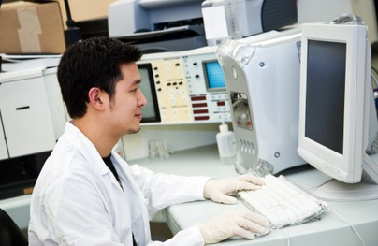
Participants are “Absent” in Our Work

Slide 5
OHRP Guidance (2004, 2008) Coded Private Information and Specimens
“Under certain limited conditions, research involving only coded private information or specimens is not human subjects research.”
45 CFR 46.102 Definitions:
(f) Human subject means a living individual about whom an investigator conducting research obtains:
(1) Data through intervention or interaction with the individual, or
(2) Identifiable private information.
http://www.hhs.gov/ohrp/humansubjects/guidance/cdebiol04.pdf
Notes:
5

Slide 6
Human Subjects Protections Belmont Report, 1979
Respect for Persons: protecting the autonomy of all people and treating them with courtesy and respect;
Beneficence: maximizing good outcomes for humanity and research subject, while minimizing or avoiding risks or harm; and
Justice: ensuring reasonable, non-exploitative, and well-considered procedures are administered fairly (the fair distribution of costs and benefits).
http://ohsr.od.nih.gov/guidelines/belmont.html

Slide 7
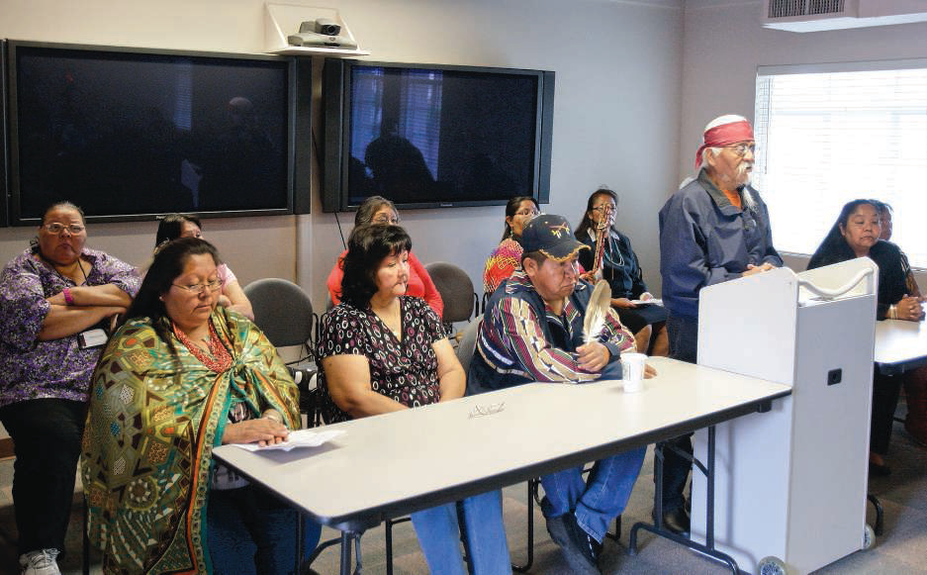
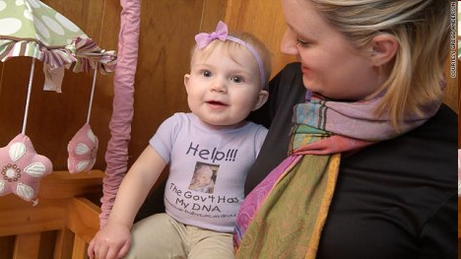
And Attendant Consequences….

Slide 8
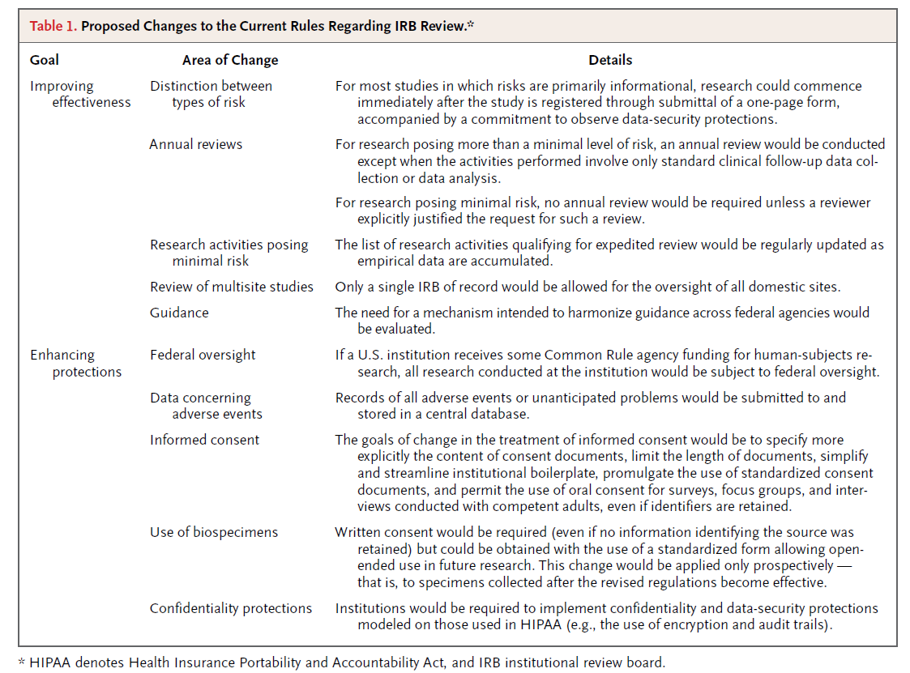
Proposed Changes to the Common Rule
Emanuel & Menikoff (2011) NEJM

Slide 9
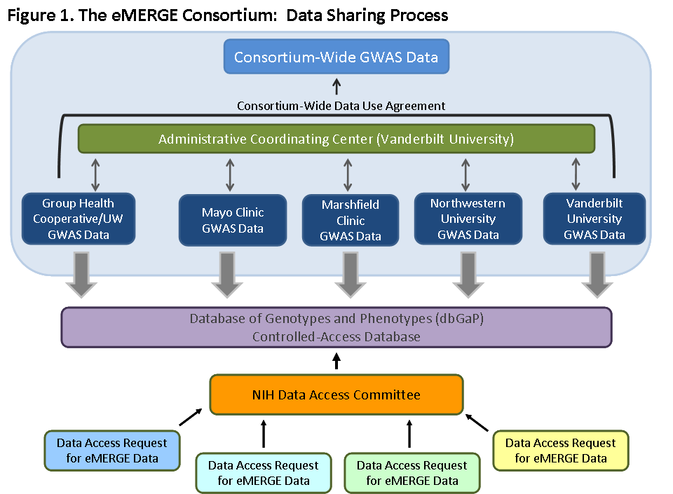
McGuire et al. (2011) Genom Res

Slide 10
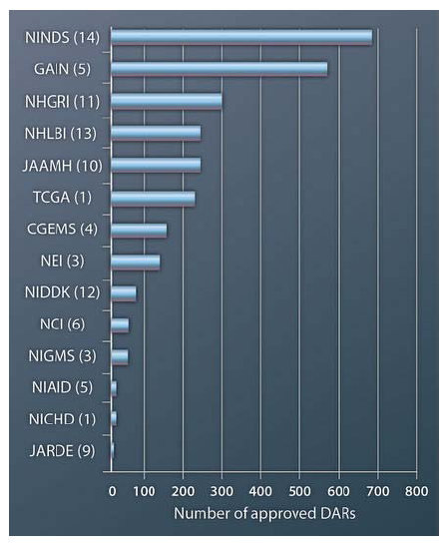
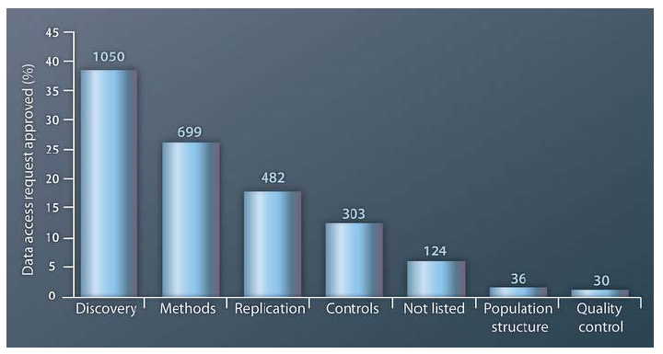
dbGaP Data Access Requests
Walker et al. (2011) Sci Transl Med

Slide 11
Adult Changes in Thought Study Re-Consent for dbGaP Deposition
Group Health IRB required re-consent for dbGaP submission
By mail (n=1340) or in person study visit (n=353)
86% of cognitively intact participants contacted by mail agreed to have their de-identified data sent to dbGaP; 90% of in-person consents

Slide 12
Attitudes of the Re-consented
Re-consent study invited first 400 mail consenters to participate in telephone interview
91% (n = 365) completed the interview
Was It Important We Asked?
90% of participants said it was important that they were asked permission for data sharing
69% rated it “very important”
21% “somewhat important”
Ludman et al (2010) JERHRE

Slide 13
Participants as Stakeholders?
Innovations to enhance respectful engagement:
Methods to keep participants informed
Ways to provide access to information about how samples are being used, on individual or study-wide basis
Transparent, accountable oversight processes
Opportunities for participants to provide input on stewardship of their data
If re-contact infeasible, methods to communicate with the public about responsible, realistic study procedures
Trinidad, et al. (2011) Science

Slide 14
Patient-Centric Research Initiatives
Kaye, et al. (2012) Nat Rev Genet

Slide 15
Summary
A major challenge is making “visible” research participants, whose DNA and health information are essential for meaningful progress
Data suggest research participants DO care about how their data are used and wish to be kept informed (NB different from control); more data are needed
Sustained investment in respectful engagement promises to reap long-term research benefits

Slide 16
Thanks To
Electronic Medical Records & Genomics Network (NHGRI)
Julie Bares, Gail Jarvik, Eric Larson, Evette Ludman, Sue Trinidad
Melissa Basford (Vanderbilt), Ellen Wright Clayton (Vanderbilt), Lynn Dressler (UNC), Barbara Koenig (Mayo), Cathy McCarty (Marshfield), Amy McGuire (Baylor), Erin Ramos (NHGRI), Maureen Smith (Northwestern), Carol Somkin (KP), Wendy Wolf (CH Boston)
Center for Genomics & Healthcare Equality (NHGRI)
Wylie Burke, Dana Gold, Rose James, Amy Lemke, Helene Starks, Holly Tabor, Lorelei Walker, Kate McGlone West, Ben Wilfond
Institute for Translational Health Sciences (NCRR)
Nick Anderson, Kelly Edwards, Greg Guzauskas, Dena Freeman

Slide 18
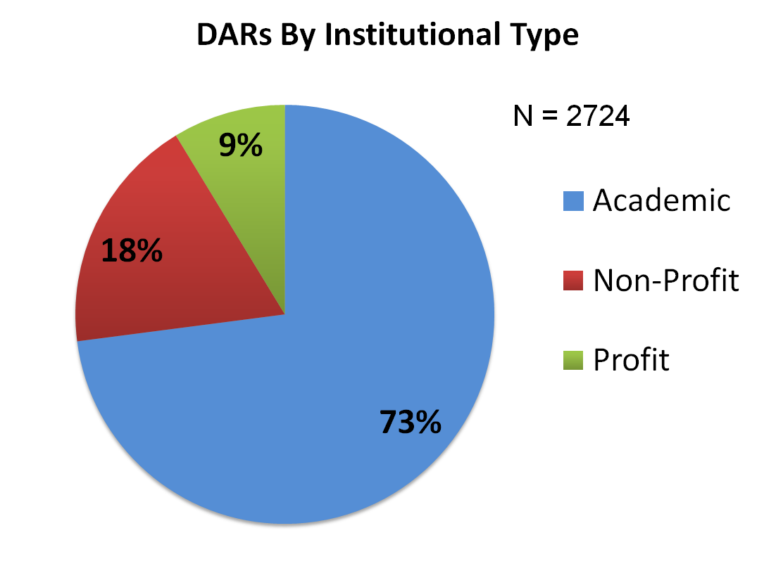
With Whom dbGaP Data Are Shared
Walker et al. (2011) Sci Transl Med

